Slide 1
Cassava Leaf Disease Detection
Presented By:
Gijin T George
TKM23MCA-2029
Guided By:
Dr. Sheeba Krishna
Date:8/11/2024

Slide 2
INTRODUCTION
Cassava is a crucial food and nutrition security crop cultivated by small-scale farmers and it can survive in a brutal environment. It is a significant source of carbohydrates in many countries.
This project develops an automated Cassava leaf disease detection system using deep learning models ResNet50, Efficientnet, Mobilenet.
Models are trained on the diverse Cassava-leaf-disease-classification dataset to ensure accurate disease identification.
The goal is to provide farmers with a fast, reliable solution, improving crop management and food security.

Slide 3
PROBLEM STATEMENT
Cassava leaf disease identification must be treated on a priority basis to improve production capacity. The automatic detection of crop diseases focused on crop leaves is critical in crop production.
Due to limited awareness and resources, many farmers struggle to detect cassava leaf diseases early and apply appropriate interventions, which results in untreated disease conditions that further reduce crop yield and farmers' income.
This project addresses these issues by developing an automated cassava leaf disease detection tool using deep learning to provide quick and accurate diagnoses, enabling accessible and proactive crop health management for farmers.

Slide 4
LITERATURE REVIEW
TITLE | AUTHORS | PUBLISHED YEAR | PUBLISHER | ALGORITHM USED
Enhanced Convolutional Neural Network Model for Cassava Leaf Disease Identification and Classification | UmeshKumarLilhore, Nitin Goyal, Subhendu KumarPani | 2022 | MDPI | Inception V3 ResNet50 DenseNet169 Xception
Early Detection of Cassava Plant Leaf Diseases using EfficientNet-B0 | Vijayalata Y, Nikhil Billakanti, Lokesh Kota | 2022 | IEEE | EfficientNet-B0 Decision Tree CNN

Slide 5
Gap Identification(Existing System)
Low Detection Accuracy: Existing models often fail to achieve high accuracy, which limits their effectiveness in real-world applications where precise identification is crucial.
Poor Handling of Imbalanced Datasets: Cassava leaf disease datasets are typically imbalanced, with certain diseases underrepresented.
Limited Real-Time Application: Many current detection methods are not optimized for real-time use, which is essential for prompt intervention and management of diseases in agricultural settings.
Preprocess the PlantVillage dataset by cleaning and augmenting images.
Implement and train CNN, AlexNet, and ResNet models, then compare their performance.
Evaluate model accuracy and select the best-performing architecture.

Slide 6
Proposed System
Accurate Detection: The deep learning model accurately identifies various cassava leaf diseases, enhancing diagnostic precision for improved crop health management.
Advanced Feature Extraction: Leverages transfer learning for improved feature extraction from cassava leaf images.
Real-Time Analysis: Farmers receive immediate feedback on uploaded images, allowing them to quickly identify the presence of diseases for timely intervention.

Slide 7
Methodology
Dataset Selection: Used the Cassava-leaf-disease-classification dataset from Kaggle for training.
Model Selection: Used 3 models: ResNet50, EfficientNet, MobileNet.
Model Training: Trained the model using selected dataset, implemented early stoppage to avoid overfitting.
Evaluation: Evaluate the models using training and validation accuracy and loss to assess their performance during training.

Slide 8
Methodology
Model Testing: Use a separate test set that was not seen during training or validation to test the final model’s performance.
Deployment: A Flask application was developed to deploy the chosen model, enabling users to upload cassava leaf images for disease classification.
Documentation: The project is documented with all the steps, including dataset selection, model architecture, training, evaluation, testing, and deployment.

Slide 9
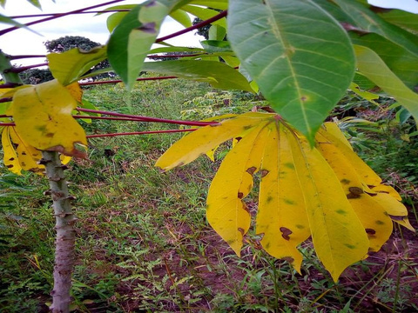
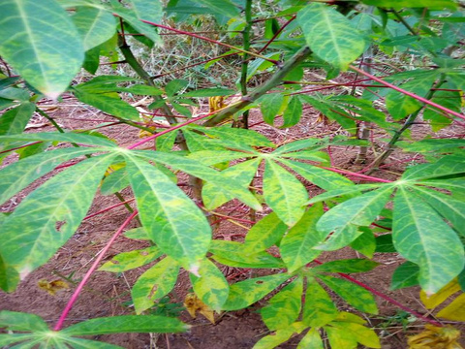
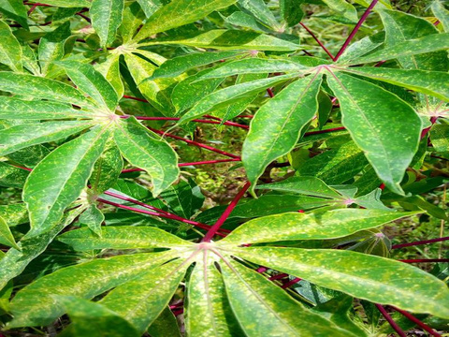
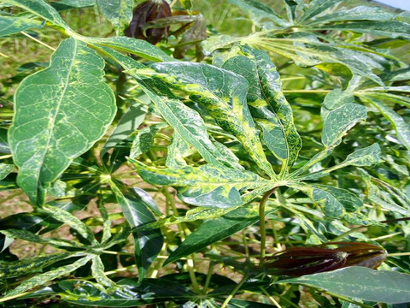
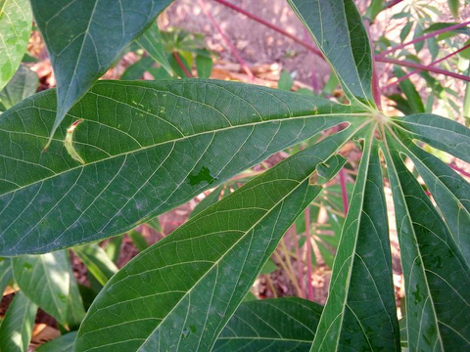
Dataset
Cassava Bacterial Blight
Cassava Brown Streak Disease
Cassava Green Mottle
Cassava Mosaic Disease
Healthy

Slide 10
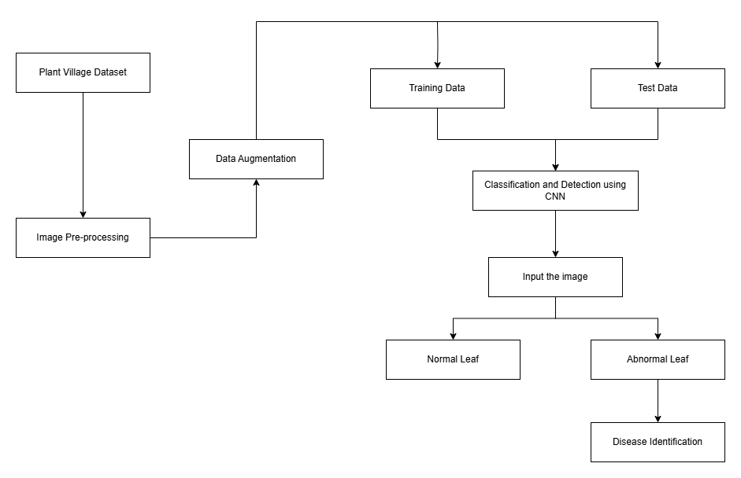
Block Diagram
Cassava leaf disease classification
ResNet50

Slide 11
Results
 | ResNet50 | EfficientNet | Mobilenet
Training Accuracy | 93.65%9 | 87.85% | 87.94%
Validation Accuracy | 93.95% | 87.76% | 88.23%
Test Accuracy | 94.75% | 89.53% | 88.87%

Slide 12
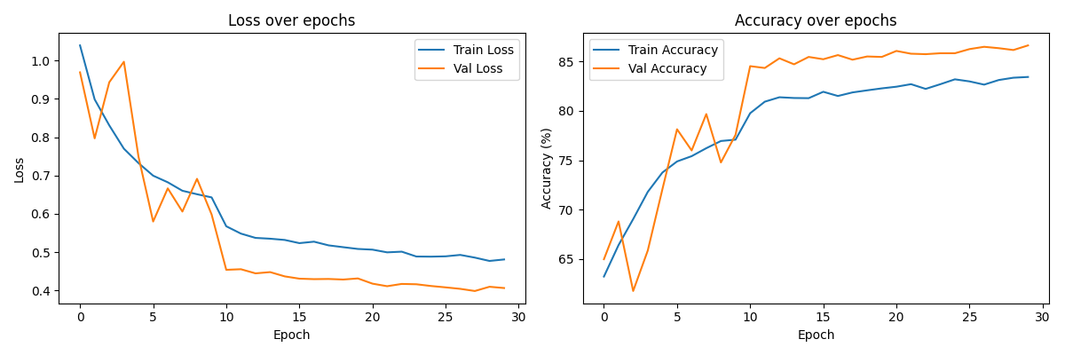
Evaluation Curves - ResNet50

Slide 13
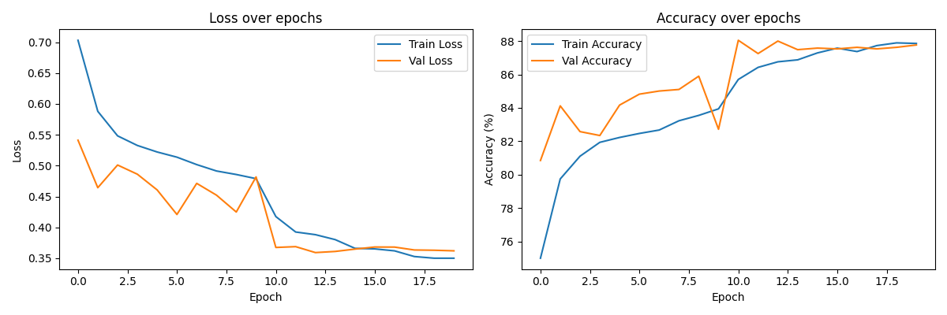
Evaluation Curves - EfficientNet

Slide 14
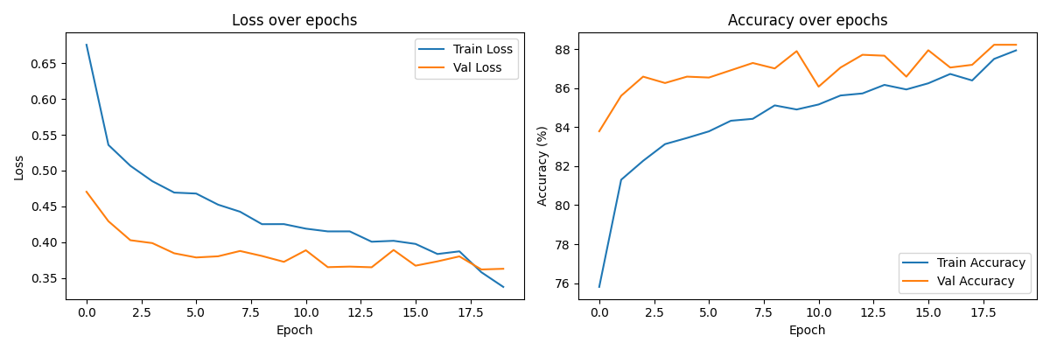
Evaluation Curves - MobileNet

Slide 15
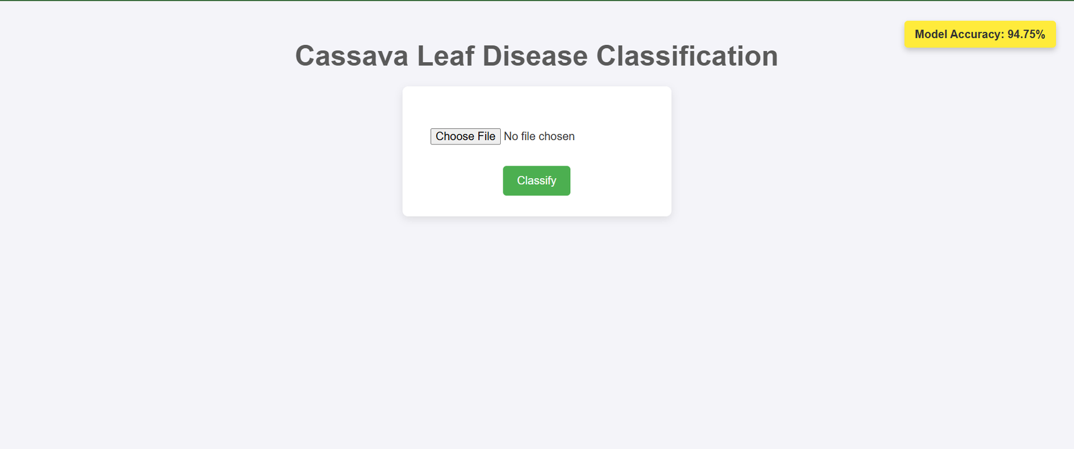
Screenshots

Slide 16
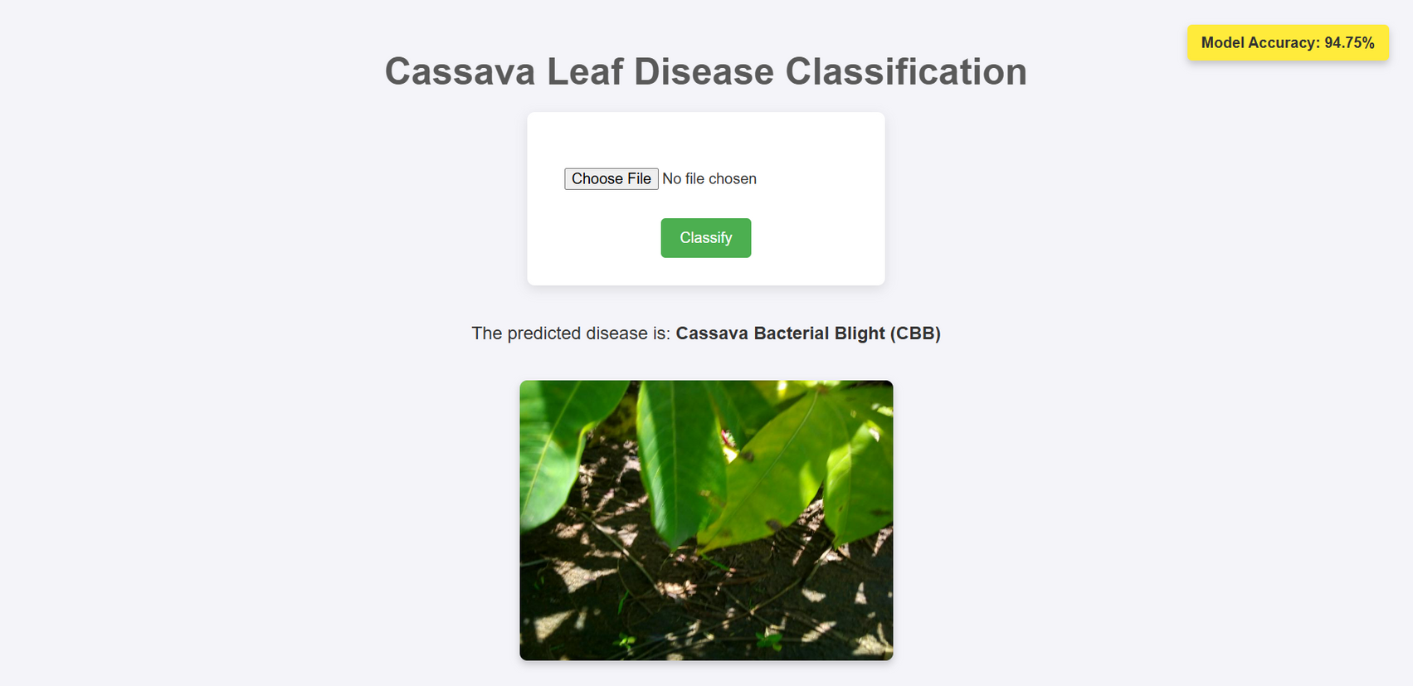

Slide 17
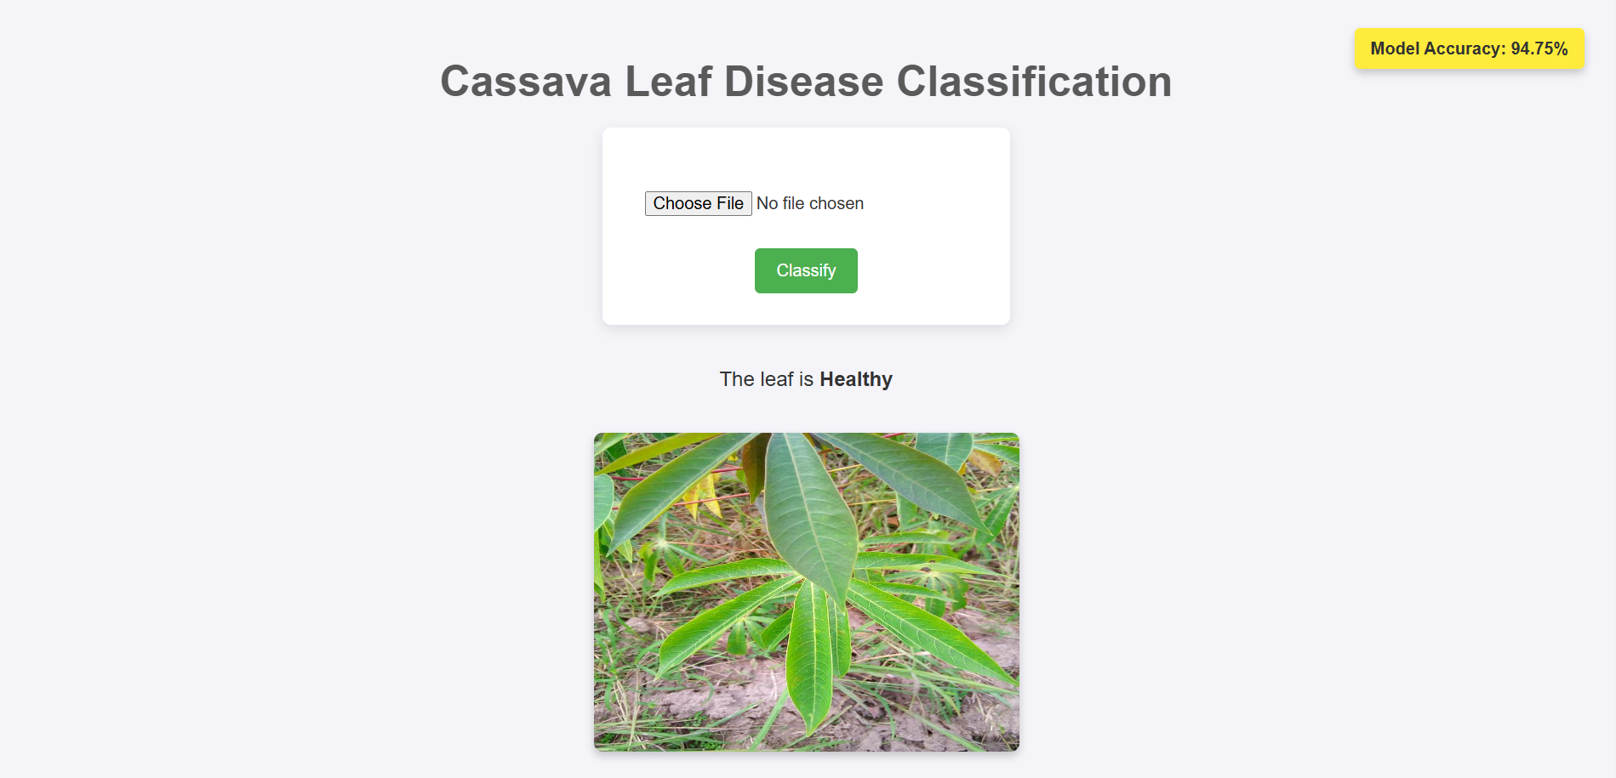

Slide 18
Future Scope
Mobile and Edge Computing: Developing a lightweight version of the model for deployment on mobile devices can enable real-time detection in the field, benefiting farmers who need immediate insights.
Multi-Disease and Early Detection: Extend the model to detect multiple diseases in a single leaf image and identify early-stage symptoms for proactive intervention.
Weather and Soil Data: Including contextual data like weather, soil quality, and other environmental factors could help the model consider more factors that might contribute to disease spread and severity.
Expert-in-the-Loop Systems: Allowing agricultural experts to provide feedback on model predictions can improve accuracy and help the model learn from corrections.

Slide 19
Thank you!

